Slide 1
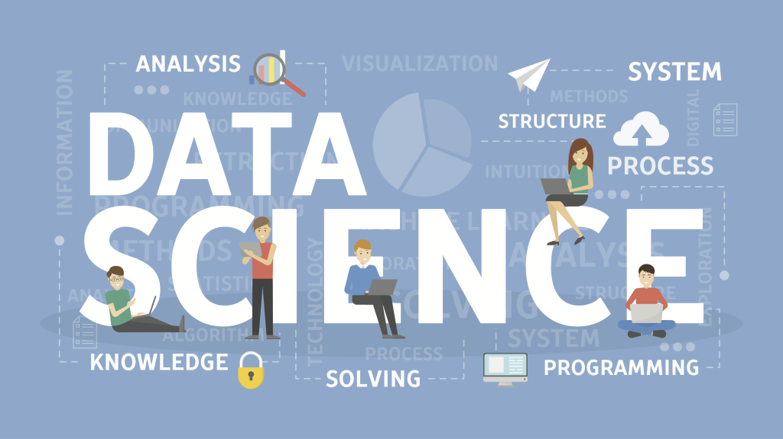
SHIELD TECHNOLOGIES
By:
Raju

Slide 2
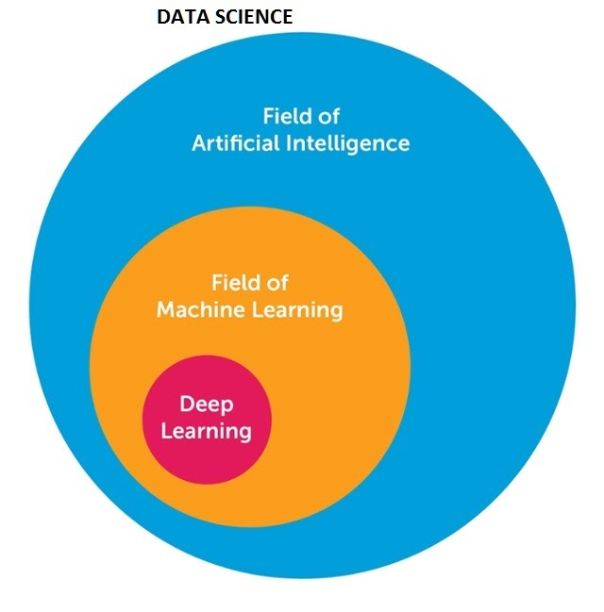
machine learning vs AI vs Data Science vs Deep learning

Slide 3
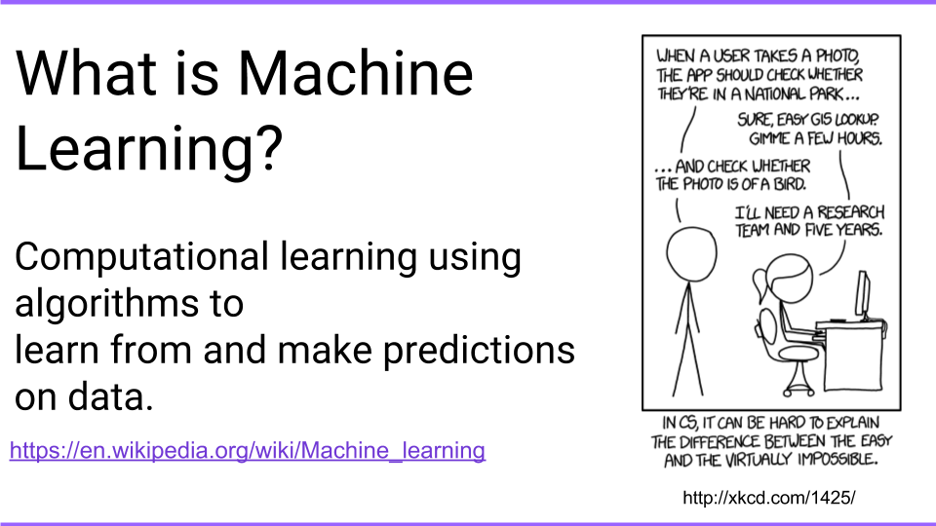
what is machine learning

Slide 4
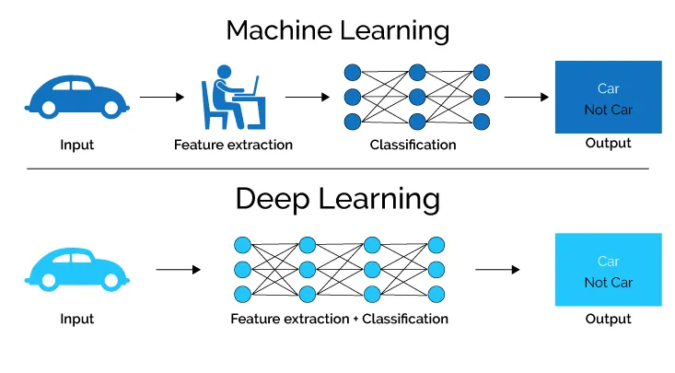
what is deep learning

Slide 5
case study
Car travelling on road which have sign boards.

Slide 6
case study
MI: The car has to recognize a stop sign using its cameras. We construct a dataset of millions of photos of streetside objects, and train an algorithm to predict which have stop signs in them.
AI: Once our car can recognize stop signs, it needs to decide when to take the action of applying the brakes. It’s dangerous to apply them too early or too late, and we need it to handle varying road conditions (for example, to recognize on a slippery road that it is not slowing down quickly enough), which is a problem of control theory.
Data science: In street tests we find that the car’s performance isn’t good enough, with some false negatives in which it drives right by a stop sign. After analyzing the street test data, we gain the insight that the rate of false negatives depends on the time of day: it is more likely to miss a stop sign before sunrise or after sunset. We realize that most of our training data included only objects in full daylight, so we construct a better dataset including nighttime images and go back to the machine learning step.

Slide 7
thank you

